Slide 1
IHIE Overview
2019
Drew Richardson
VP, Business Development

Slide 2

My Path
Exercise Science
Personal Trainer
Corporate Wellness – 3 Roles
MBA
Technology Company -2 Roles
IHIE – 3 Roles
Notes:
118 hospitals out of 125, data on 92% of the population, 1K hospitals outside of IN
Data on 99% of the Indy metro area
Largest, 1 of first in nation, 14 yrs. Built by Regeinstrief through grant, needed a supporting entity so created IHIE.
117 hospitals- 12 Billion health related data elements
501C3
Mission: improve quality and get data to clinicians/staff when they need it. Why is HIE important? patients get care everywhere.

Slide 3

Vital Statistics
MISSION
Through information exchange,
we improve health and healthcare.
Nation’s largest HIE
  117 hospitals, representing 38 health systems
  Data on 92% of the Indiana population
  17,000+ practices with over 49,000 providers
  15 million+ patients
  12.8 billion clinical data elements
Board Composition: Hospital System CEOs, Healthcare Associations, Academia, State, Community
Regenstrief Institute partnership
A 501(c)3 supporting organization
HITRUST Certified
Notes:
118 hospitals out of 125, data on 92% of the population, 1K hospitals outside of IN
Data on 99% of the Indy metro area
Largest, 1 of first in nation, 14 yrs. Built by Regeinstrief through grant, needed a supporting entity so created IHIE.
117 hospitals- 12 Billion health related data elements
501C3
Mission: improve quality and get data to clinicians/staff when they need it. Why is HIE important? patients get care everywhere.

Slide 4
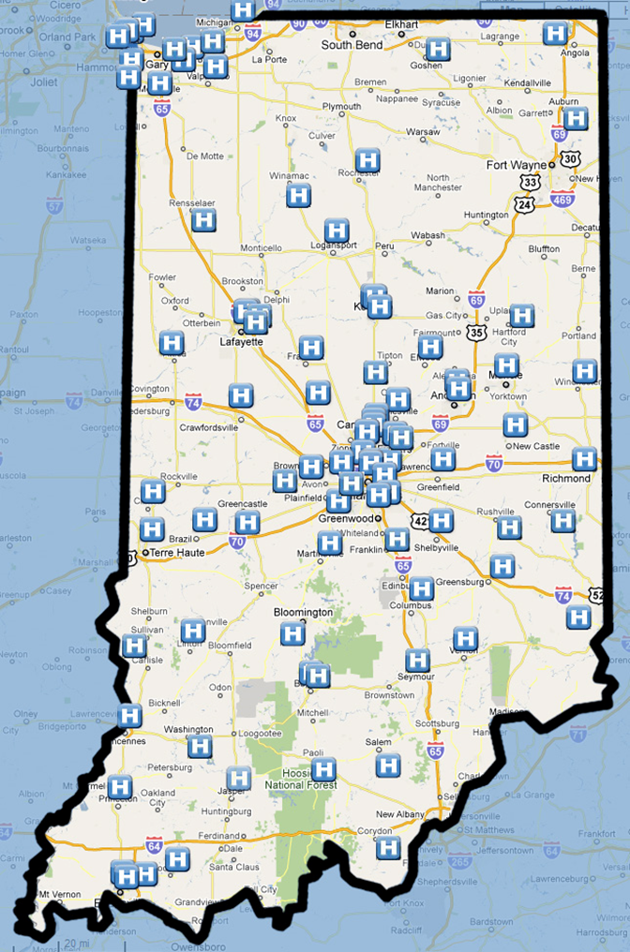
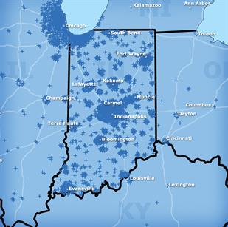
Our “Footprint”
Hospitals
Physician Practices
Notes:
Large IN footprint that continues to grow as we add more service lines. Hospitals/where we deliver results.

Slide 5
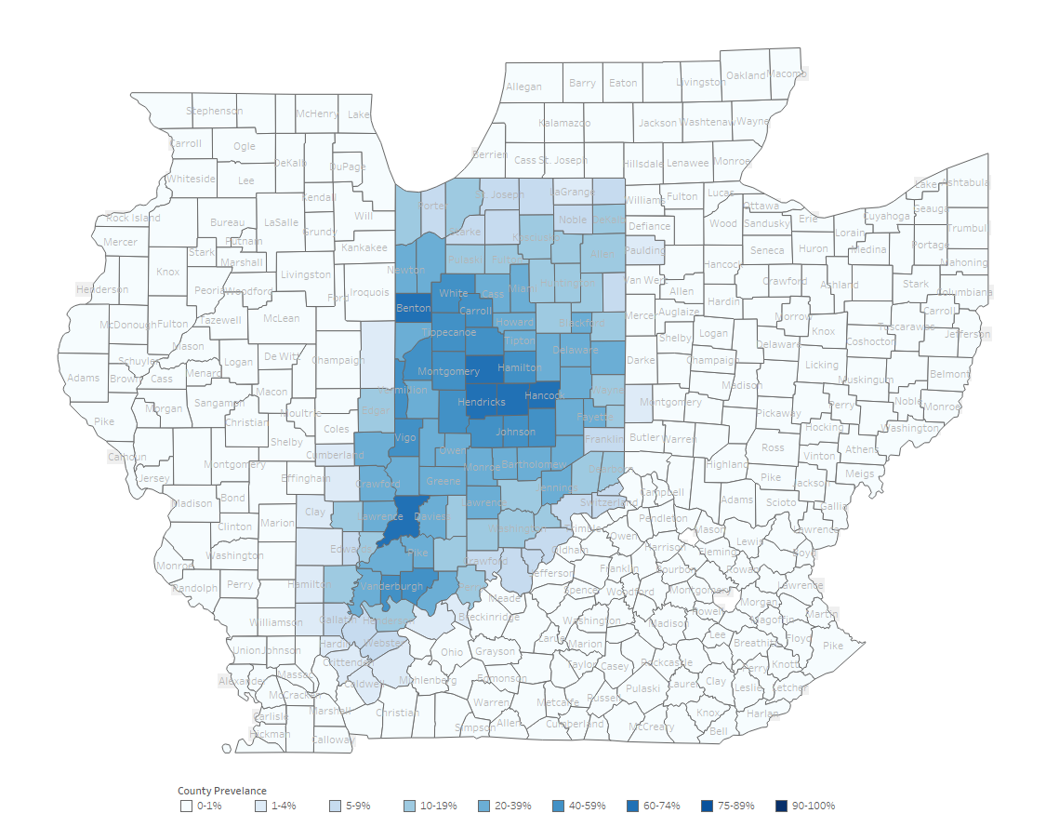
Percentage of Indiana population
with an encounter in the INPC
2010

Slide 6
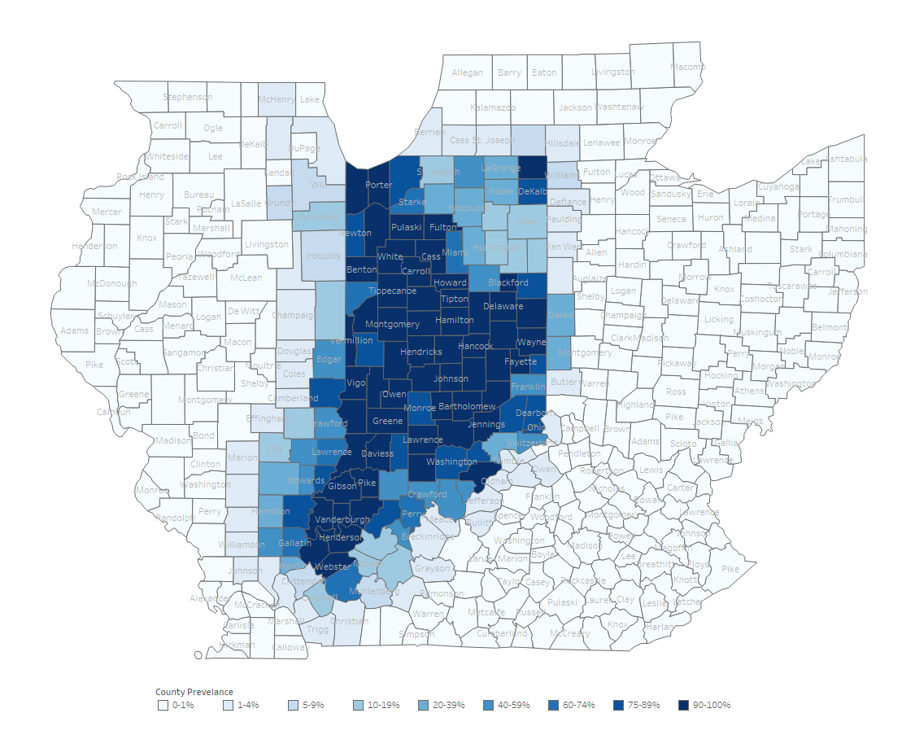
Percentage of Indiana population
with an encounter in the INPC
2018

Slide 7








Our Customer Base
 | Hospitals |  |  | Long-term/Post-acute Care (LTPAC)
 | Payers |  |  | Physicians
 | Federal Government |  |  | Public Health
 |  |  |  | Labs and Imaging Centers
Give to Get
Notes:
Our footprint is growing as we add additional service lines- goal is to get data to all the folks who touch patient care from birth to death.
Today mostly hospitals, insurance providers and physician offices, focused on growing LTC, EMS, Employer Health clinics
Work with Public health & govnmt, many time for free just to get the data flowing
Give get model in efforts to have a full picture
Not only in IN but all across the US

Slide 8


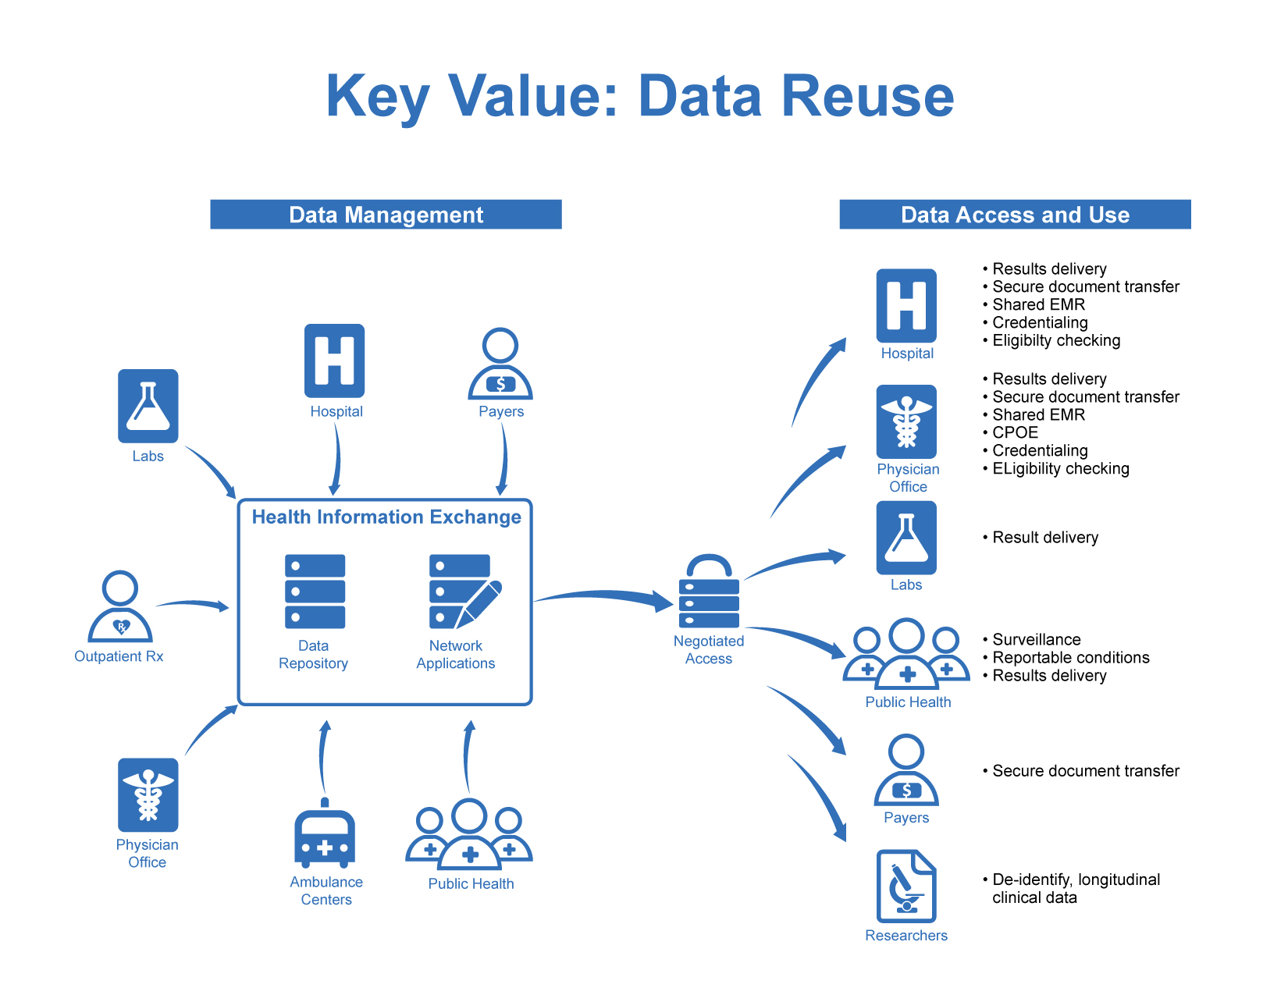








How HIE
Produces Value
Health Data Sources
Value-Added Services
Clinical Data Repository (INPC™)
MPI & Record Locator Service
Longitudinal Patient View
SSO with patient context
CareView quick access
Clinical Results Delivery (D4D)
Web-based portal or EMR delivery
ACO & Population Health Mgmt.
Clinical Event Notifications (ADT Alerts)
Clinical values report
Population Health dashboard-PopDash
Public Health Integration and Automation
Bio-surveillance
Communicable Disease Reporting
Immunizations
Federal Government Services
SSA Disability Determination
VA’s VLER Program
Meaningful Use Supporting Services
Transitions of Care
Public Health Integration
CCD Connect
Hospitals
Physician
IHIE
Physician Offices
Health Information Exchange
Labs/
Imaging Centers
Patient
Physician
Public Health
Data Repository
Data Stewardship
Secure VPN
Physician
Payers
Outpatient Rx
Notes:
IHIE is data steward for central repository of data (INPC). INPC sits in the middle waiting for trigger (ED visit, inpatient stay, MD visit). Once triggered, IHIE combs through DB and delivers the longitudinal view of that patients records across the entire continuum of care.
Accessed by secure VPN so covered from a security standpoint. Govnd by INPC committee made up of charter hospitals.
Our tools break down into 2 categories

Slide 9
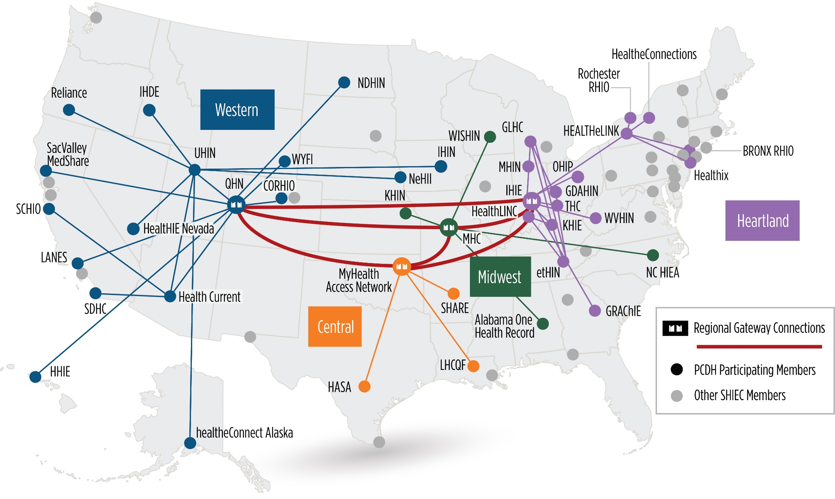
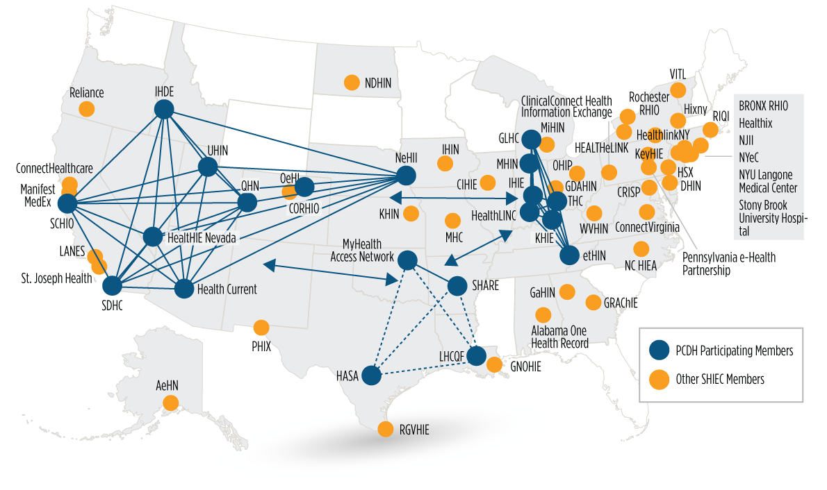
Patient Centered Data Home
Notes:
Over 5 Mill transactions
PCDH national collaborative, using patient zip codes, we route ADT’s to 26 HIE’s, across 4 regions--IHIE is the post office for our geographical region. Heartland directly, others a hub in the region
Why important: better outcomes/process improvements, less duplication, more saved lives. Ex: St Francis MD saw a patient for sever stomach pains, able to see RAD report through CW, knew immediately it was a bleeding aneurysm.
Here’s how it works

Slide 10

IHIE Products & Services

Slide 11



Review of Services
 | One Care This suite includes some of our most popular products, such as DOCS4DOCS and CareWeb. One Care offers solutions to improve the health of the INDIVIDUAL PATIENT.
 | Pop Care Products in the Pop Care suite allow providers to track patients, measure progress and analyze data for a specific segment of the population. Pop Care provides insight into POPULATION HEALTH.
Notes:
1) One care- a patient is in front of the MD. Includes:
Docs4docs- electronic post office for labs, radiology, results. Timely, not missed in a stack of papers or the patient forgot to bring them with them to the office
Careweb- portal provides a longitudinal record view, quick search
2) PopCare- Huge data repository--care coord- panel of patients they are managing ex: ACO, quality programs, wellness, identifying high risk, trends.
Made up of care manager access, ADT alerts, CSV file
In summary, we are dedicated to improving health care through exchanging important information when its needed most to make better clinical decisions and reduce risk and the cost of healthcare.

Slide 12



Access patient data quickly and securely
Trend lab data to understand the full story of the patient
Search clinical results data by keyword
Customize your electronic delivery options
A secure, web-based application that displays patient information from the Indiana Network for Patient Care™,
IHIE’s robust clinical data repository. It provides access to critical clinical information when and where it is needed.
An electronic results delivery service that offers a single source for clinical information such as lab results, radiology reports, hospital admission reports, and more. Results can be viewed through a web-based portal or delivered directly into an EHR system.

Slide 13

Track where patient care is delivered
Access discrete data within EHRs
Support quality metric efforts
Manage patient’s transition of care
ADT Alerts
Care Manager
Clinical Value Reports
Support the patient/primary provider relationship, address appropriate usage of healthcare resources, and ultimately reduce healthcare costs for any managed care organization.
Delivering 1.6 Million ADT alerts on IN residents
Customized form of CareWeb access to real time and historical INPC community data for a specific segment of the population. Uses a “google like” search feature.
A customized report to assist your organization in care management for specific populations and quality metric efforts.
Delivering 2.4 Million CVR reports on IN residents
Notes:
Delivering CVR to 55% of the population (minus children and young adults). That’s over ½ the population in IN.
3 services that we provide under pop care; ADT alerts-when a patient is presenting somewhere. Loading patients on ADT sites, when a match, we create a file alert and send to FTP site. Case mgrs. have access to CareWeb for their ADT patient) Found that 50% of their care is outside of Franciscan. Clinical value reports—800 coded elements, injection fraction always on non-coded data, we are going to be getting from Reigenstrief. that includes Medicare patients unstructured and structured. Franciscan is sucking into their analytics. Sucking into the big health systems analytics system. Drew is looking for smaller orgs, us doing analytics for them.

Slide 14


Public Health Integration & Automation
Public Health Emergency Surveillance System (PHESS)
Statewide infrastructure to analyze “primary complaint” data from Indiana emergency departments for the early detection of:
  Acts of bioterrorism
  Other public health emergencies
Communicable Disease Reporting
Notifiable Conditions Detector (NCD)
ONC-certified technology for electronic lab reporting
Immunizations
Children and Hoosier Immunization Registry Program (CHIRP)
Bi-Directional CHIRP
Notes:
Working with Dept of health. MU some groups went direct thru us for ED. After 911 most go through state.

Slide 15

Questions?

